Slide 1

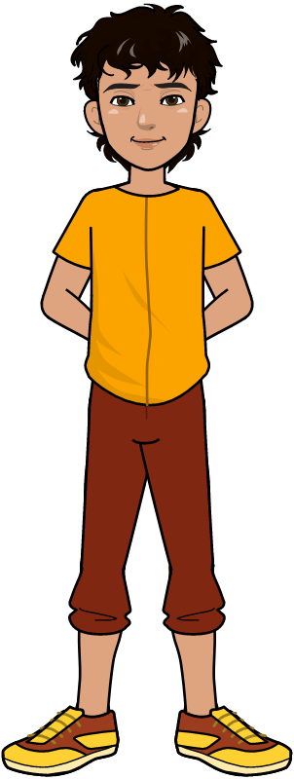
Functions
In
Python

Slide 2

Learning Objectives
Explain how to define and write functions
Illustrate how to call functions
Analyze how to pass different arguments to functions
Demonstrate how to return a value from functions
Computer Science Department, UET Lahore.

Slide 3

Working Example
Write a Python Program to calculate sum of two number
For Example:
Computer Science Department, UET Lahore.

Slide 4
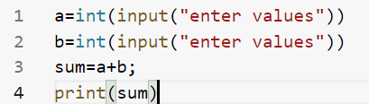
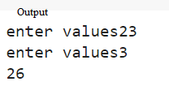
Is there any better Solution?
Computer Science Department, UET Lahore.

Slide 5
Is there any better Solution?
Better solution in terms of readability and simplicity.
Yes, there is.
But before moving to the solution lets take a real life example of Automobile factory.
Computer Science Department, UET Lahore.

Slide 6
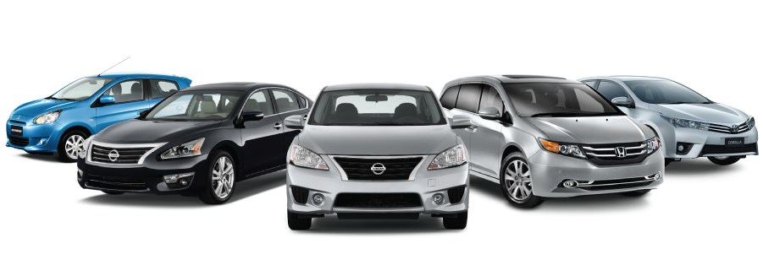
Automobiles in Factory
How do the automobiles are created in the factory?
Computer Science Department, UET Lahore.

Slide 7
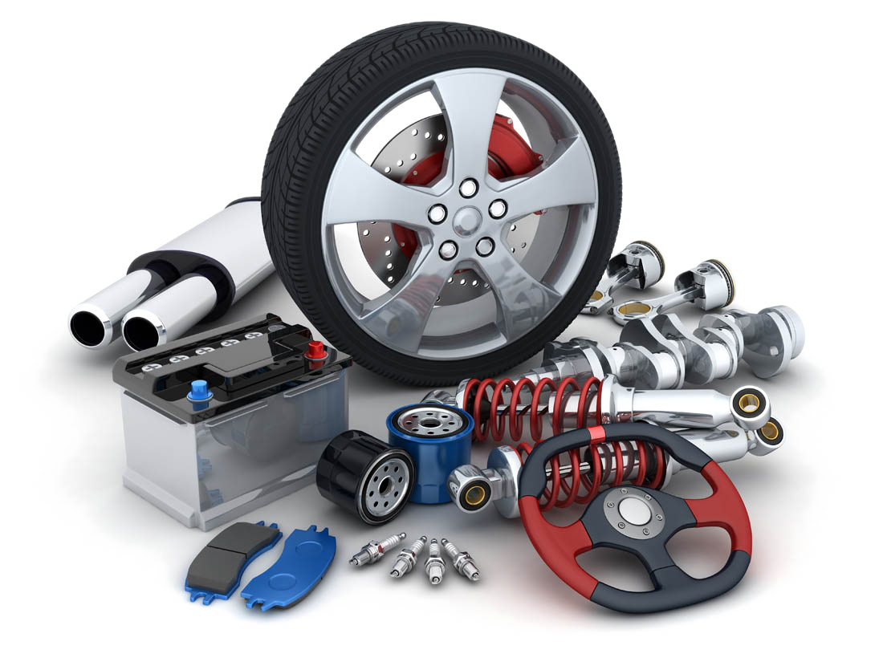
Components of Automobiles
Wheels, Brakes, Engine, Steering Wheels etc are the components of the car.
Computer Science Department, UET Lahore.

Slide 8
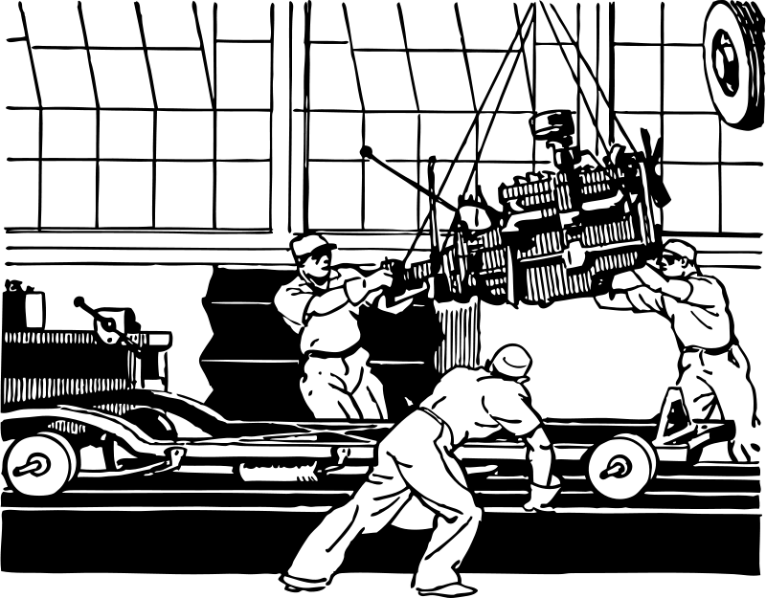
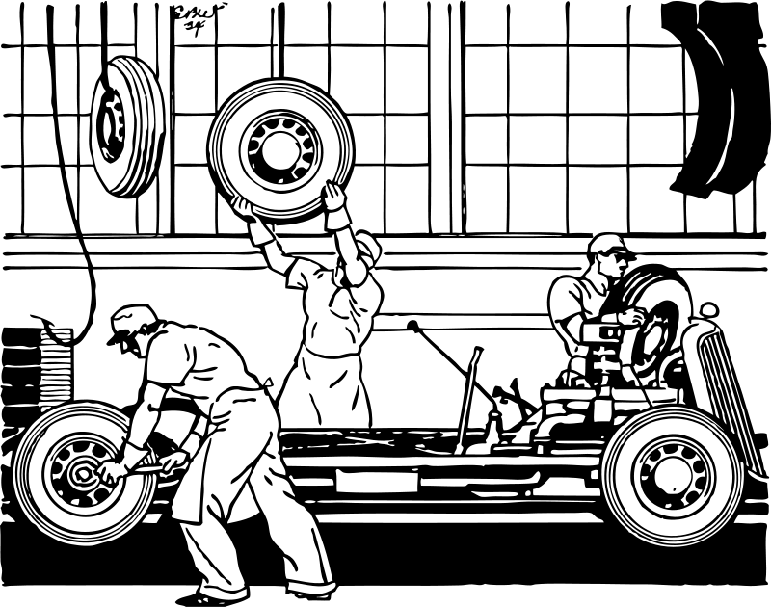
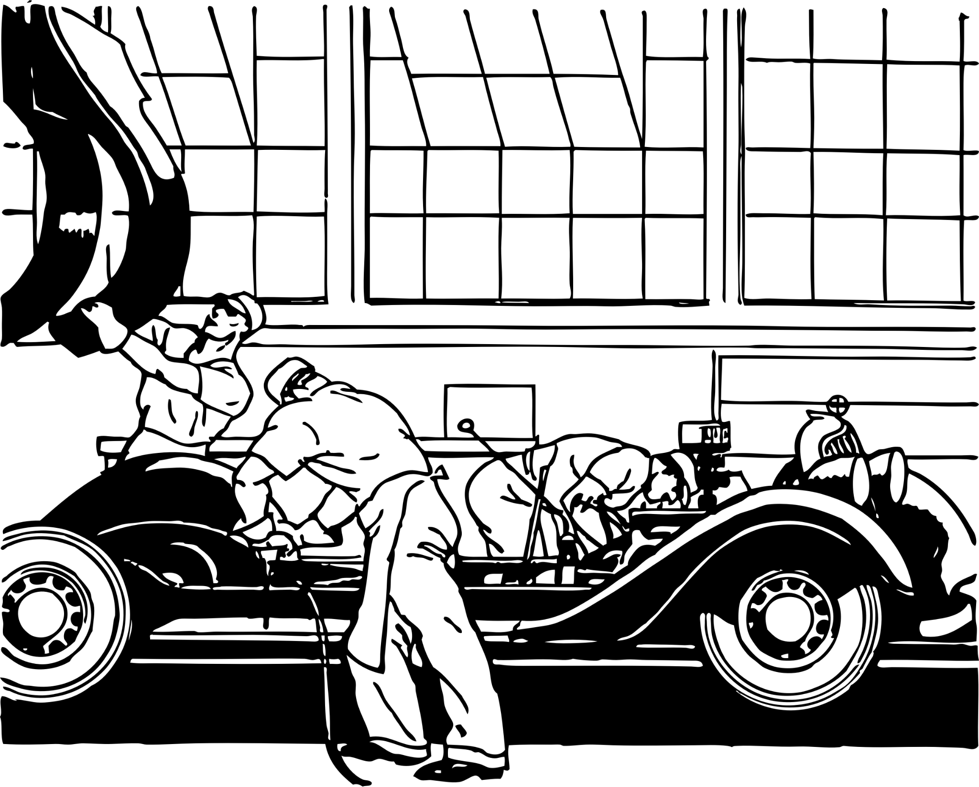
Automobiles in Factory
Wheels, Brakes, Engine, Steering Wheels are manufactured separately and they are assembled in the automobile factory.
Computer Science Department, UET Lahore.

Slide 9
Functions
Functions are like short programs that can take input, process on it, and may return the results
Functions are like building blocks. They let you divide complicated programs into manageable pieces
Computer Science Department, UET Lahore.

Slide 10
These Functions are called user-defined functions because they are defined by the users. For the program’s simplicity and more readability, users can define as many functions as they want.
User-Defined Functions:

Slide 11
User-Defined Functions: Benefits
Functions make the code reusable. We can declare them once and use them multiple times.
Functions make the program easier as each small task is divided into a function.
Functions increase readability.
Computer Science Department, UET Lahore.

Slide 12

Functions: How to Create?
Functions are defined using “def” keyword in python.
Parameters are inputs to the function and they are separated by commas.
“return” is the keyword for returning the output
Example:
Computer Science Department, UET Lahore.

Slide 13
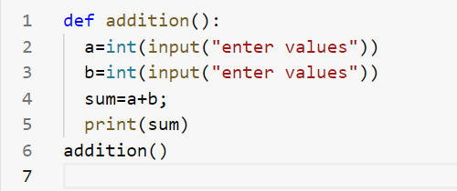
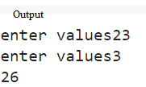
Functions: How to Call?
Functions are called by writing the name of the function and passing the parameters(if required) to the functions.
Output of the function is received in a new variable.
Computer Science Department, UET Lahore.

Slide 14
Functions: Previous Example
Computer Science Department, UET Lahore.

Slide 15
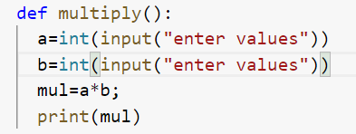
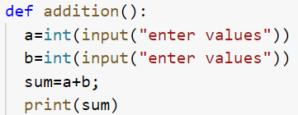

Functions: Previous Example
Computer Science Department, UET Lahore.

Slide 16

User-Defined Functions with parameter:
Here syntax of user define function with parameter
Computer Science Department, UET Lahore.

Slide 17


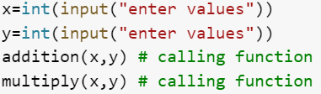
Example

Slide 18
Two-types of Functions:
User-Defined Functions
Pre-Defined (Library) Functions
Computer Science Department, UET Lahore.

Slide 19
Pre-Defined (Library) Functions:
Library functions are the built-in functions in Python programming.
Programmers can use library functions by invoking the functions directly; they don't need to write the functions themselves.
Computer Science Department, UET Lahore.

Slide 20
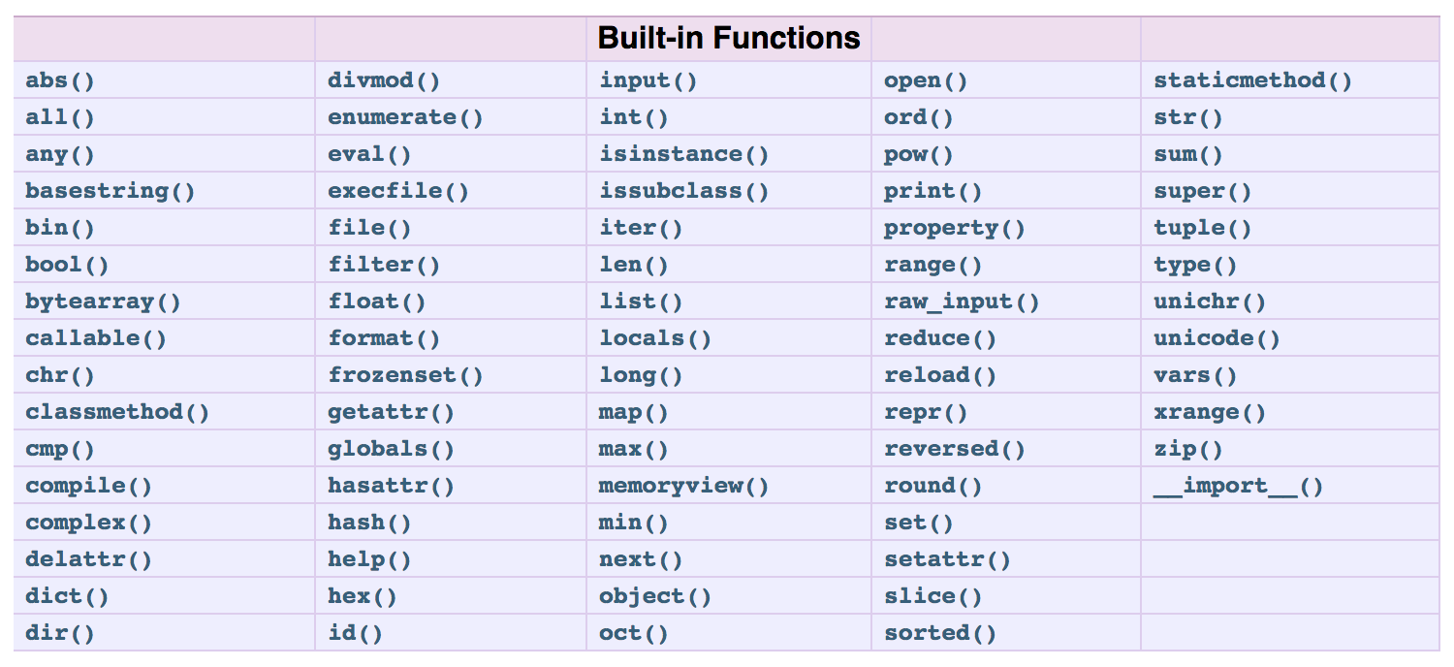
Built-in Functions: Python Standard library
Computer Science Department, UET Lahore.

Slide 21
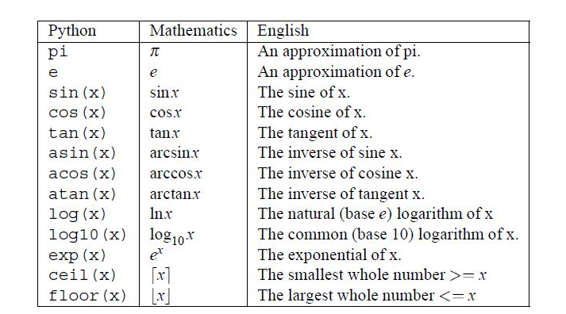
Built-in Functions: with importing math library
import maths
Computer Science Department, UET Lahore.

Slide 22
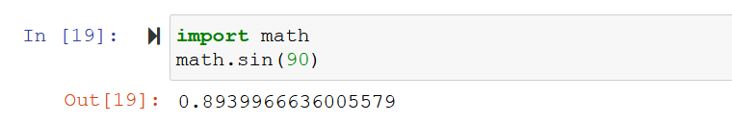
Built-in Functions: with importing math library
For Example:
Computer Science Department, UET Lahore.

Slide 23

Learning Objective
In this lecture, we learnt about functions, how to define functions with different parameters, differentiate between built-in and user-defined functions.
Computer Science Department, UET Lahore.

Slide 24
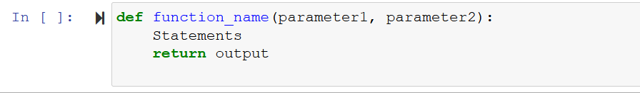
Conclusion
A function is a block of organized, reusable code that is used to perform a single, related action.
Functions are of 2 types
Built-in Functions User-defined Functions
Functions can have zero or more parameters.
Syntax to define and call Functions is as follows:
Computer Science Department, UET Lahore.

Slide 25
Take Home Tasks
1. Create a function that takes the age in years and returns the age in days.
Note:
Use 365 days as the length of a year for this challenge.
Ignore leap years and days between last birthday and now.
Expect only positive integer inputs.
Examples:
calcAge(65) ➞ 23725
calcAge(0) ➞ 0
calcAge(20) ➞ 7300
Computer Science Department, UET Lahore.

